Slide 1

P peline
The Data
Information Visualization
© Jennifer Mankoff
The Data Pipeline; HCII; Spring 2014
Slides cribbed from Marti Hearst http://courses.ischool.berkeley.edu/i247/f05/ (slides 2-10, 16, 19-21, 23, 25-37); Jian Huang, based on a tutorial by Daniel Kiem (slides 39-58); Beomjin Kin (11-14, 17-18)

Slide 2
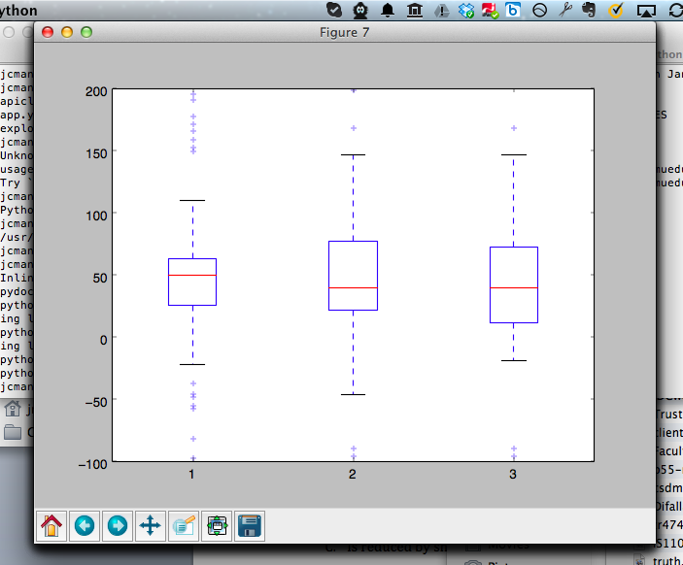
Boxplot [Random Data; 3 times]
Notes:
I made a mistake – the boxes are quartiles (25% of all data); the lines are ‘extremes’ (75% of all observations)

Slide 3
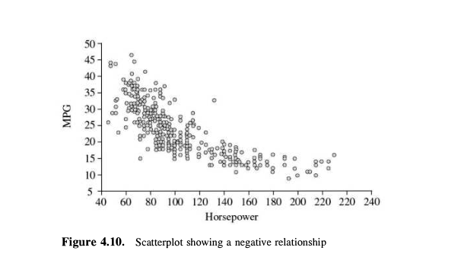
Scatterplot
Notes:
We also didn’t talk about one other very common kind of plot which lets you eyeball correlation – scatter plots

Slide 4
Introduction
Goals of Information Visualization
Case Study: The Journey of the TreeMap
Key Design Ideas
Tour of Other Visualizations
Notes:
hearst

Slide 5
What is Information Visualization?
Visualize: to form a mental image or vision of …
Visualize: to imagine or remember as if actually seeing.
American Heritage dictionary, Concise Oxford dictionary

Slide 6
What is Information Visualization?
The depiction of information using spatial or graphical representations, to facilitate comparison, pattern recognition, change detection, and other cognitive skills by making use of the visual system (Hearst 03).
“that which gives to the viewer the greatest number of ideas in the shortest time with the least ink in the smallest space.” --Edward R. Tufte

Slide 7
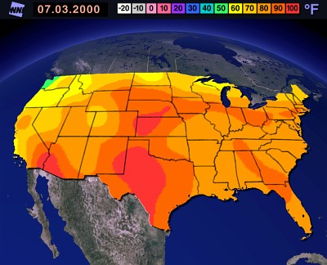
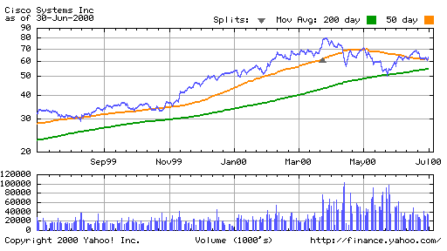
Visualization Success Stories

Slide 8
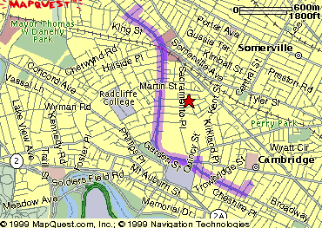
The Power of Visualization
1. Start out going Southwest on ELLSWORTH AVE
Towards BROADWAY by turning right.
2: Turn RIGHT onto BROADWAY.
3. Turn RIGHT onto QUINCY ST.
4. Turn LEFT onto CAMBRIDGE ST.
5. Turn SLIGHT RIGHT onto MASSACHUSETTS AVE.
6. Turn RIGHT onto RUSSELL ST.

Slide 9
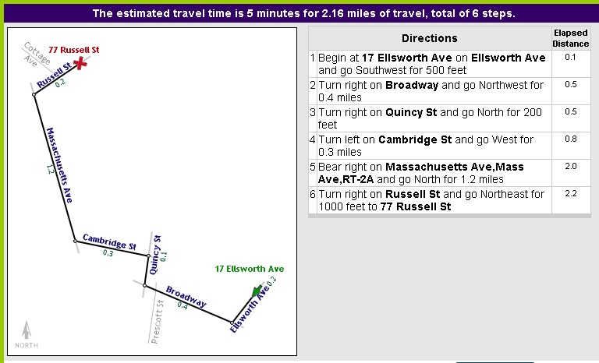
The Power of Visualization
Line drawing tool by Maneesh Agrawala http://graphics.stanford.edu/~maneesh/

Slide 10
Visualization Success Story
Mystery: what is causing a cholera epidemic in London in 1854?

Slide 11
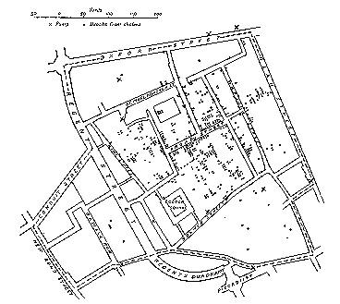
Visualization Success Story
Illustration of John Snow’s
deduction that a cholera epidemic
was caused by a bad water pump, circa 1854.
Horizontal lines indicate location of deaths.
From Visual Explanations by Edward Tufte, Graphics Press, 1997

Slide 12
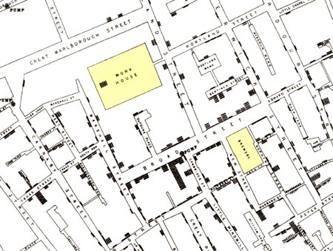
Visualization Success Story
Illustration of John Snow’s
deduction that a cholera epidemic
was caused by a bad water pump, circa 1854.
Horizontal lines indicate location of deaths.
From Visual Explanations by Edward Tufte, Graphics Press, 1997

Slide 13
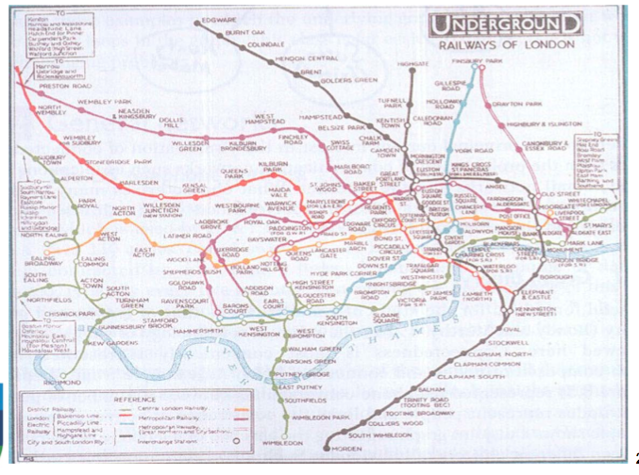
Visualization Success Story
1927 London Underground

Slide 14
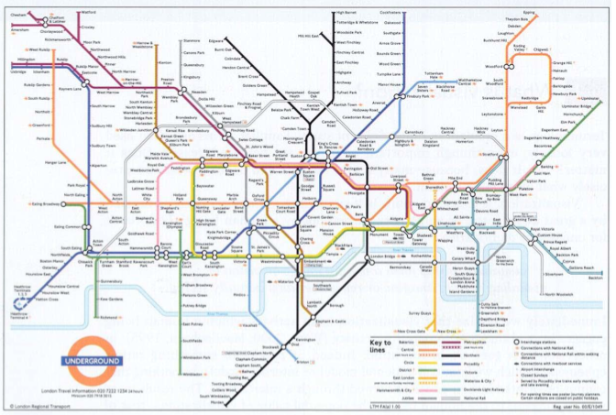
Visualization Success Story
1990s London Underground

Slide 15
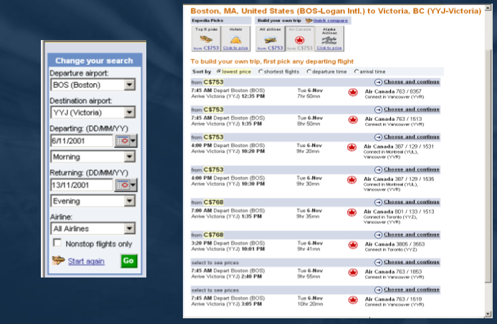
Create Your Own

Slide 16
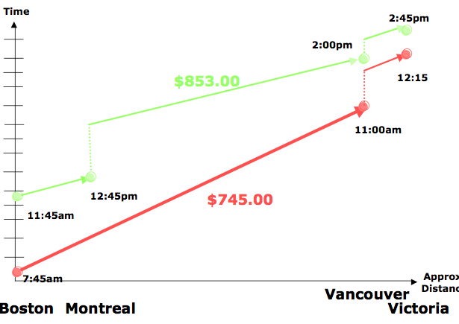
Create Your Own

Slide 17
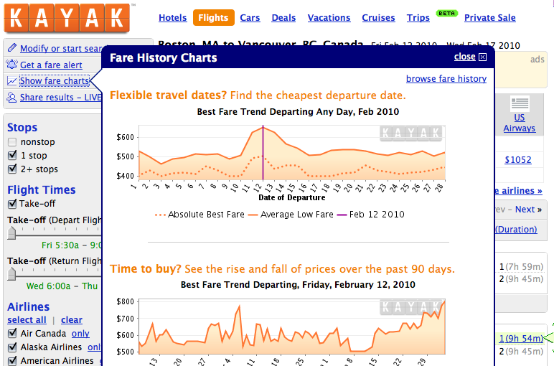
Create Your Own
Notes:
Lightweight Visualization

Slide 18
Purposes of Information Visualization
To help:
Explore
Calculate
Communicate
Decorate

Slide 19
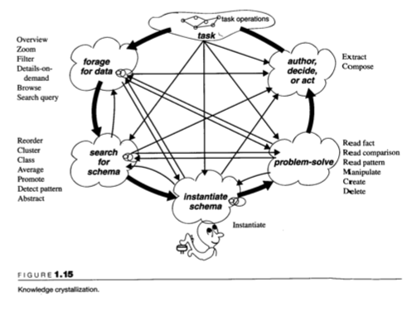
Notes:
Different ways that visualizations could help amplify cognition: 1. By increasing memory and processing resources available 2. By reducing the amount of time to search 3. Enhancing the detections of patterns and enabling perceptual inference operations 4. Aid perceptual monitoring 5. By encoding information in a manipulable medium

Slide 20
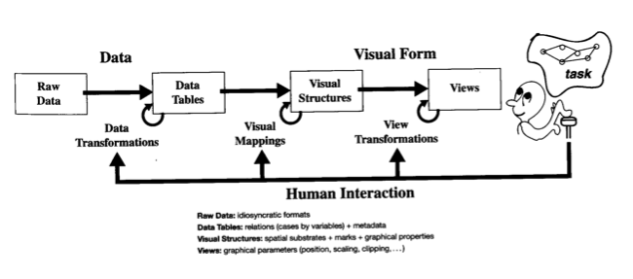

Slide 21
Two Different Primary Goals: Two Different Types of Viz
Explore/Calculate
Analyze
Reason about Information
Communicate
Explain
Make Decisions
Reason about Information

Slide 22
Two Different Primary Goals: Two Different Types of Viz
Explore/Calculate
Analyze
Reason about Information
Communicate
Explain
Make Decisions
Reason about Information

Slide 23
Communication should:
Make large datasets coherent
Compact
Multivariate
Present information from various viewpoints
Support visual comparisons [Tufte]
Tell stories about the data (causality & structure...)
Have visual integration (images, words, etc.)
Document for credibility

Slide 24
… But Remember:
“analytical presentations ultimately stand or fail depending on the quality, relevance, and integrity of their content” [Tufte, Beautiful Evidence, p. 136]

Slide 25
Taking The Viewer Into Account
Use the eye for pattern recognition: people are good at
Scanning
Recognizing
Remembering images
What they do depends on their “visual query”
Tends to be “just in time”
Key graphical elements
Length
Shape
Orientation
Texture
Animation shows changes across time
Color helps make distinctions
Aesthetics make the process appealing

Slide 26
Design Process
Define the visual query[ies] you wish to support
“The special skill of designers … [is] the talent to analyze a design in terms of its ability to support the visual queries of others…”
Patterns ⬄ visual system
Cognitive process prediction
A continual fresh eye

Slide 27
Key Questions to Ask about a Viz
What does it teach/show/elucidate?
What are some compelling, useful examples? [COPY COPY COPY!]
Could it have been done more simply?
Have there been usability studies done? What do they show?

Slide 28
Holistic Design Goals for Information Visualization
Tailor to the application and the domain
Create highly interactive and integrated systems
Embed the visualization within a larger application
Provide alternative views

Slide 29
Case Study: The Journey of the TreeMap
The TreeMap (Johnson & Shneiderman ‘91)
Idea:
Show a hierarchy as a 2D layout
Fill up the space with rectangles representing objects
Size on screen indicates relative size of underlying objects.

Slide 30
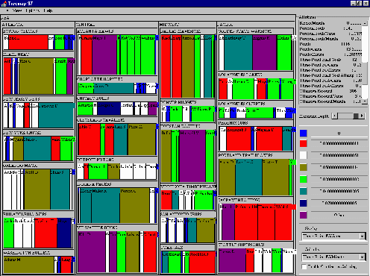
Early Treemap Applied to File System

Slide 31
Treemap Problems
Too disorderly
What does adjacency mean?
Aspect ratios uncontrolled leads to lots of skinny boxes that clutter
Color not used appropriately
In fact, is meaningless here
Wrong application
Don’t need all this to just see the largest files in the OS

Slide 32
Successful Application of Treemaps
Think more about the use
Break into meaningful groups
Fix these into a useful aspect ratio
Use visual properties properly
Use color to distinguish meaningfully
Use only two colors:
Can then distinguish one thing from another
When exact numbers aren’t very important
Provide excellent interactivity
Access to the real data
Makes it into a useful tool

Slide 33
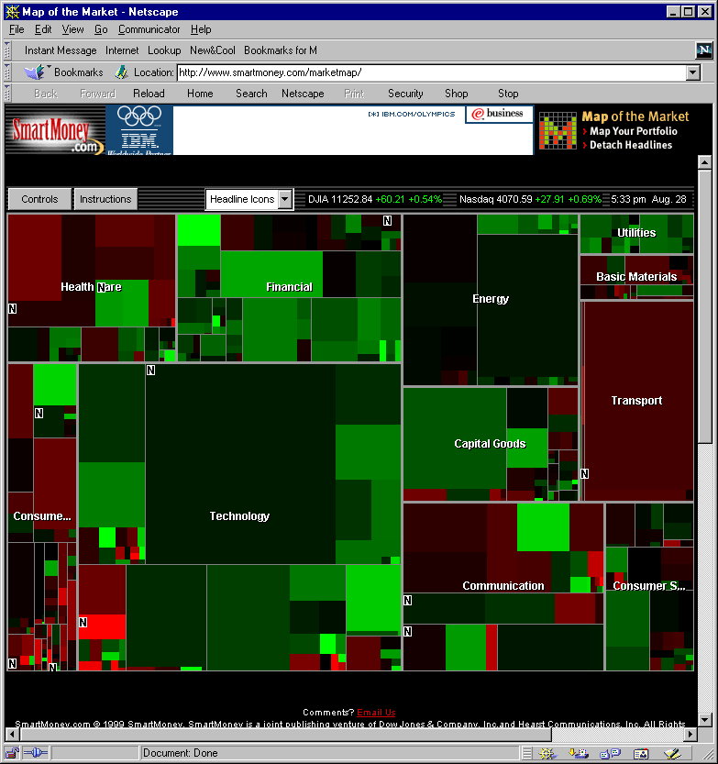
A Good Use of TreeMaps and Interactivity
www.smartmoney.com/marketmap

Slide 34
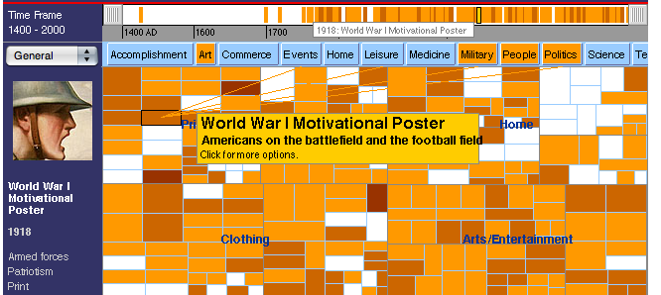
History Wired
http://historywired.si.edu/index.html

Slide 35
Analysis vs. Communication
MarketMap’s use of TreeMaps allows for sophisticated analysis
Smithsonion’s use of TreeMaps is more for presentation and communication
This is a key contrast

Slide 36
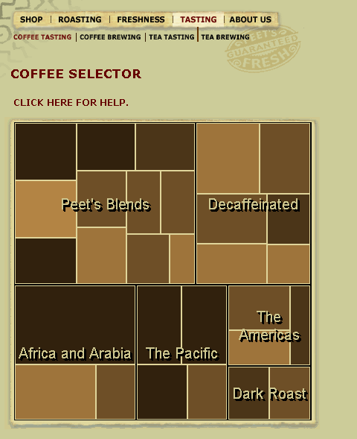
Other Treemaps

Slide 37
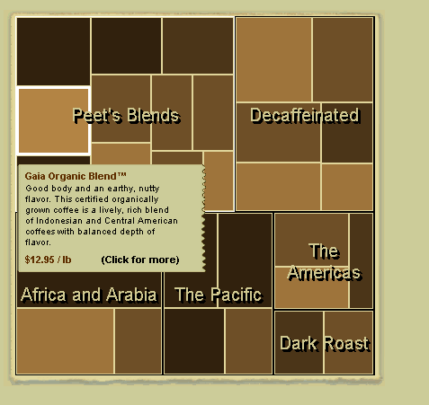
Other Treemaps

Slide 38
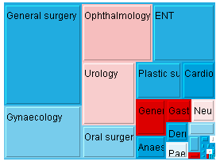
Other Treemaps
http://en.wikipedia.org/wiki/Treemapping

Slide 39
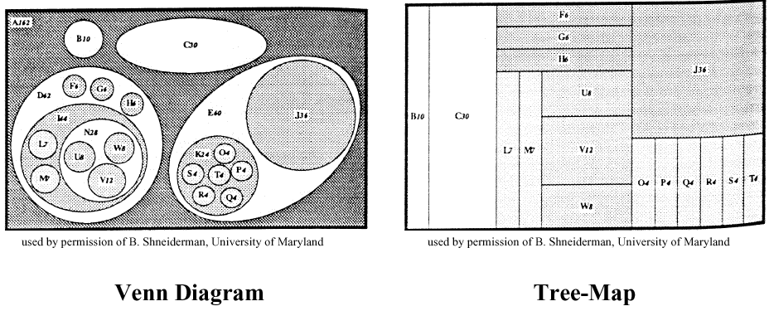
Other Treemaps
http://en.wikipedia.org/wiki/Treemapping

Slide 40
Open Issues
Does visualization help?
The jury is still out
Still supplemental at best for text collections
A correlation with spatial ability
Learning effects: with practice ability on visual display begins to equal that of text
Does visualization sell?
Jury is still out on this one too!
This is a hot area! More ideas will appear!

Slide 41
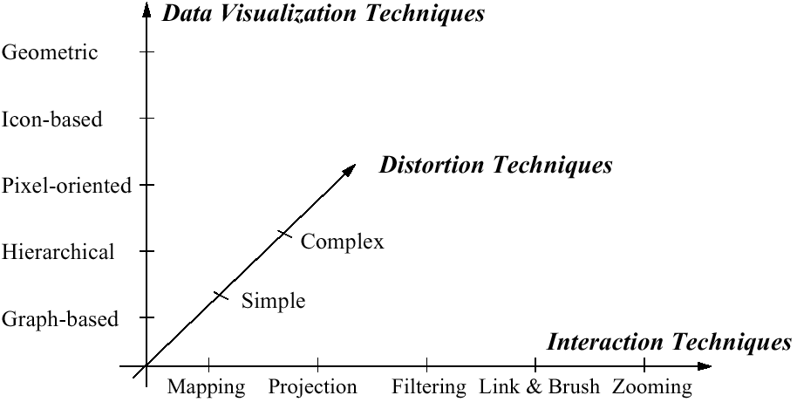
PART II Data Visualization Methods
http://www.visual-literacy.org/periodic_table/periodic_table.html
Notes:
nguyen

Slide 42
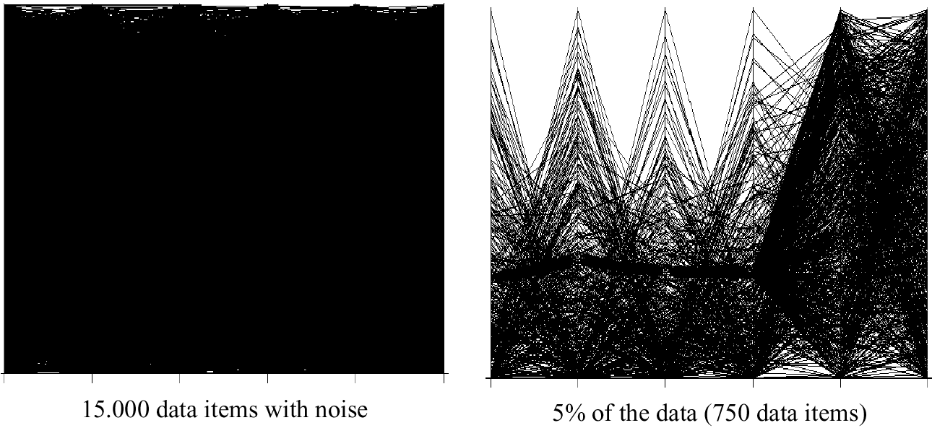
Too many data points?

Slide 43
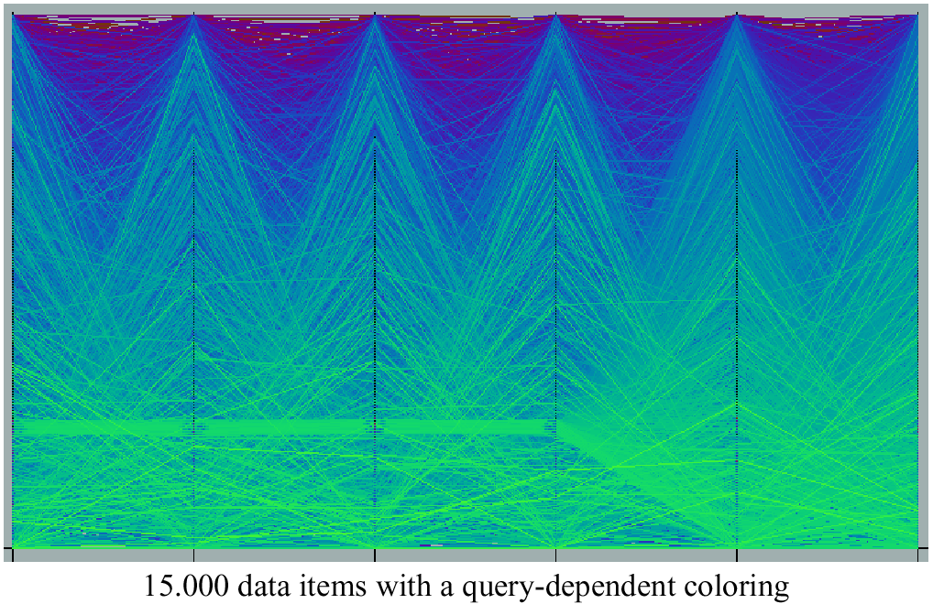
Query Dependent Coloring

Slide 44
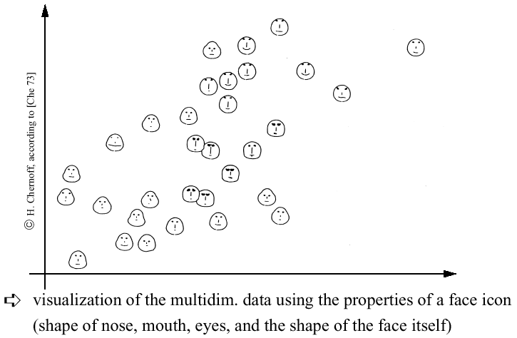
Chernoff-faces

Slide 45
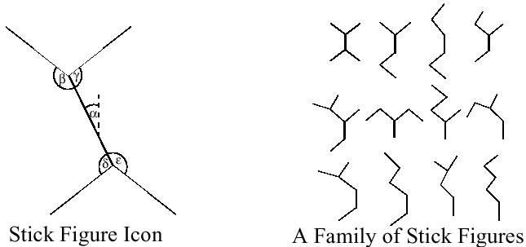
Stick Figures
Notes:
Visualization of the multidimensional data using stick figure icons
Two attributes of the data are mapped to the display axes and the remaining at-tributes are mapped to the angle and/or length of the limbs
Texture patterns in the visualization show certain data characteristics

Slide 46
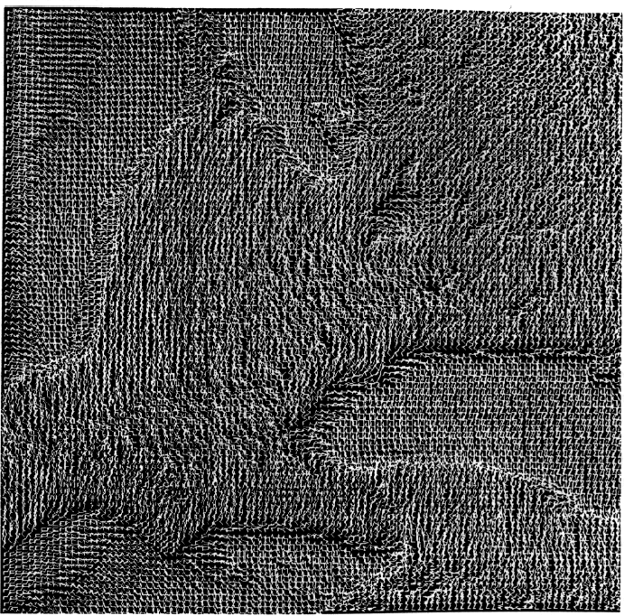
Stick Figures

Slide 47
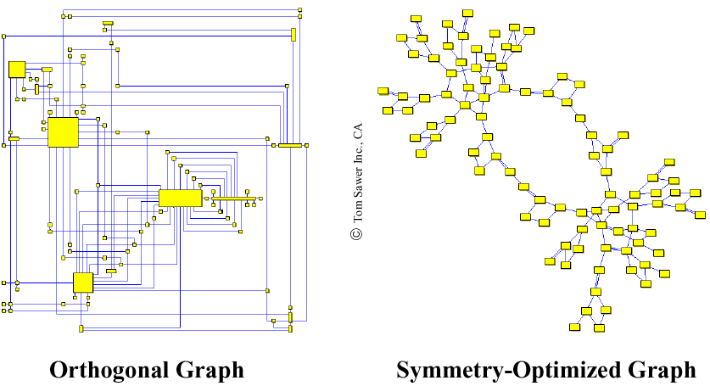
2D Graph Examples

Slide 48
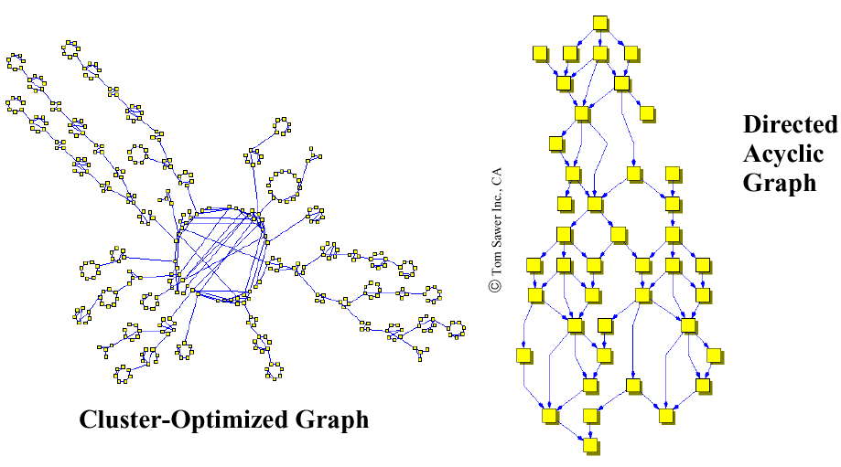
2D Graph Examples
Notes:
Properties of 2D-Graph Drawings
planarity (no line crossings)
orthogonality (only orthogonal lines)
grid property (coordinates of vertices are integers)
Aesthetics Properties (Optimization Goals)
minimal number of line crossings
optimal display of symmetries
optimal display of clusters
minimal number of bends in polyline graphs
uniform distribution of vertices
uniform edge lengths

Slide 49
2D-Graph Drawings
Properties of 2D-Graph Drawings
planarity (no line crossings)
orthogonality (only orthogonal lines)
grid property (coordinates of vertices are integers)
Aesthetics Properties (Optimization Goals)
minimal number of line crossings
optimal display of symmetries
optimal display of clusters
minimal number of bends in polyline graphs
uniform distribution of vertices
uniform edge lengths

Slide 50
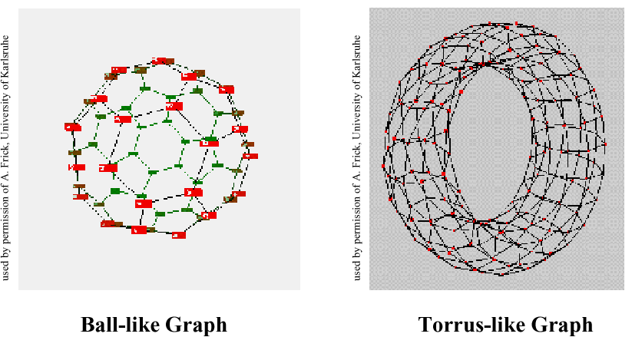
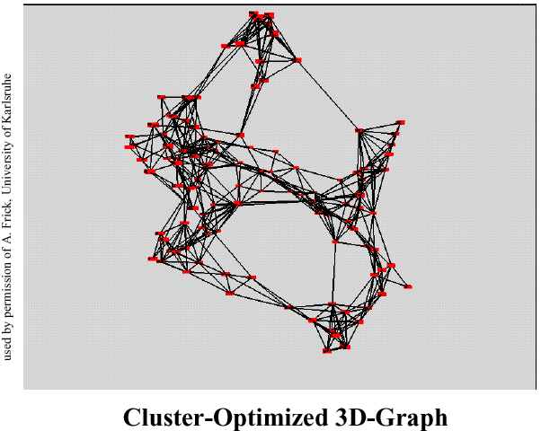
3D-Graph Drawing

Slide 51
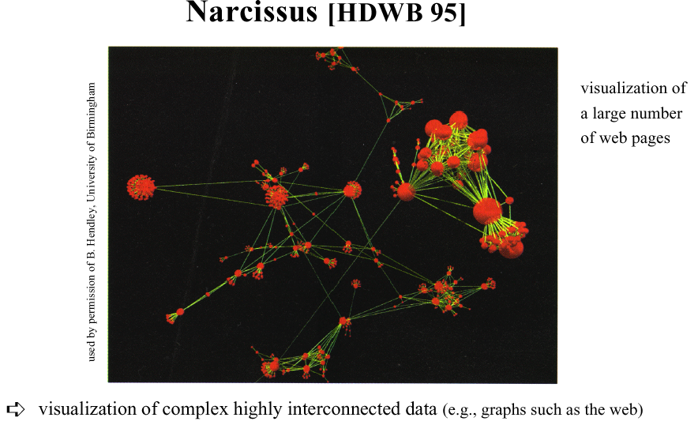
Graph-based Techniques

Slide 52
Distortion Techniques
Basic Idea: Distortion of the image to allow a visualization of larger amounts of data
Simple:
Perspective Wall [MRC91]
Bifocal Displays [SA 82]
TableLens [RC94]
Graph. Fisheye Views [Fur 86, SB94]
Hyperbolic Repr. [LR94, LRP95]
Complex:
Hyperbolic Repr. [LR94, LRP95]
3D-Hyperbolic Repr. [MB95]
Hyperbox [AC91]

Slide 53
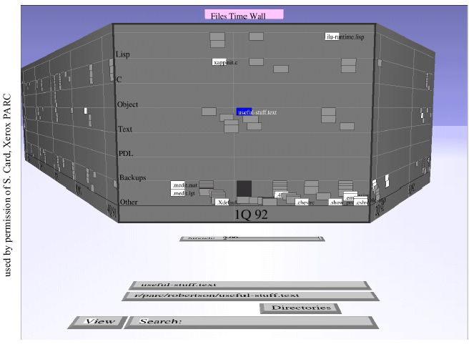
Perspective Wall
Notes:
Presentation of the data on a perspective wall
The data outside the focal area are perspectively reduced in size
The perspective wall is a variant of the bifocal lens
Display [SA82] which horizontally compresses the sides of the workspace by direct scaling

Slide 54
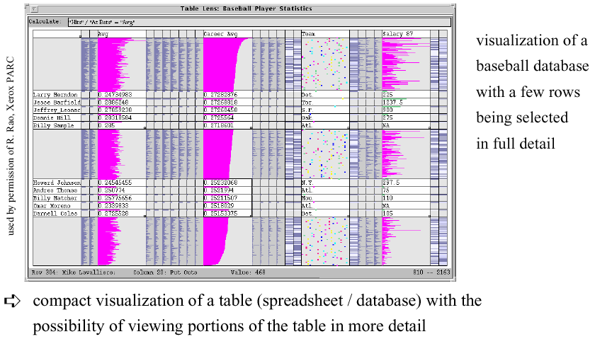
Table Lens

Slide 55
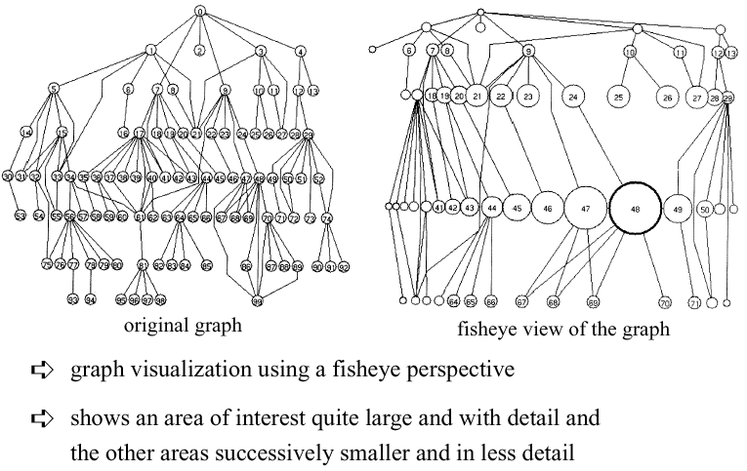
Fisheye View

Slide 56
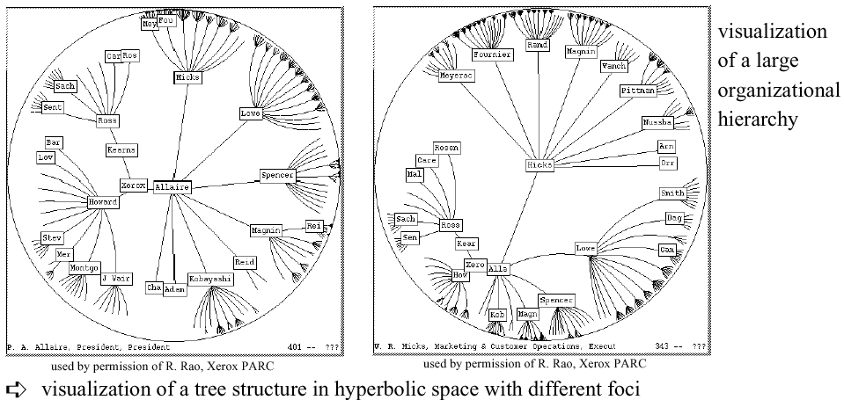
Hyperbolic Tree

Slide 57
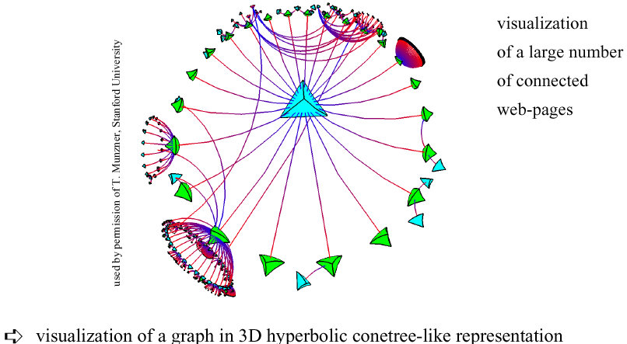
3D Hyperbolic Representation

Slide 58

Magic Lenses/Moveable Filter
interactive selection using lens-like tools which selectively filter the data in the considered areas
multiple lenses/moveable filters can be used for a multi-level filtering (allowing complex conditions)

Slide 59
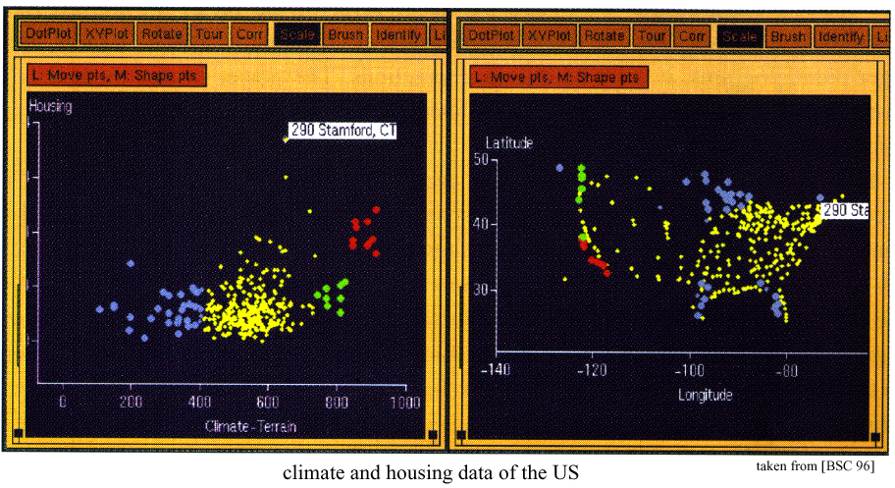
Dynamic/Interactive Linking & Brushing
Notes:
Prerequisite: multiple visualizations of the same data (e.g., visualizations of different projections)
Interactive changes made in one visualization are automatically reflected in the other visualizations

Slide 60
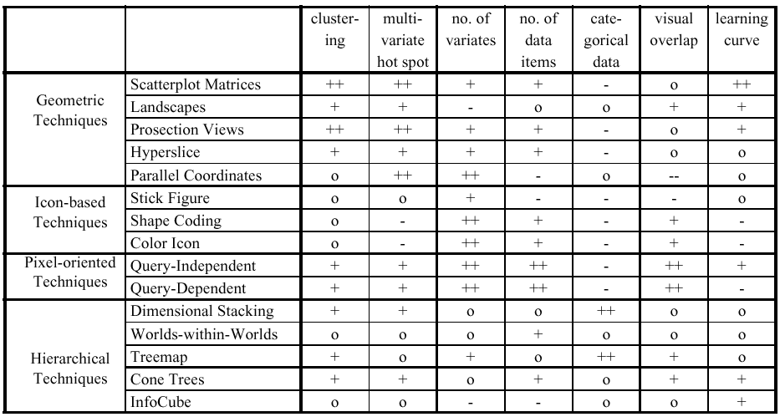
Comparison by Keim

Slide 61
Other relevant topics if this area interests you…
Scientific visualization
Statistics
Cartography (maps)
Education
Games
Computer graphics in general
Computational geometry

Slide 62
Credits & Additional Reading
http://courses.ischool.berkeley.edu/i247/f05/
Marti Hearst (slides 2-10, 16, 19-21, 23, 25-37)
Jian Huang, based on a tutorial by Daniel Kiem (slides 39-58)
Beomjin Kin (11-14, 17-18)

